Slide 1
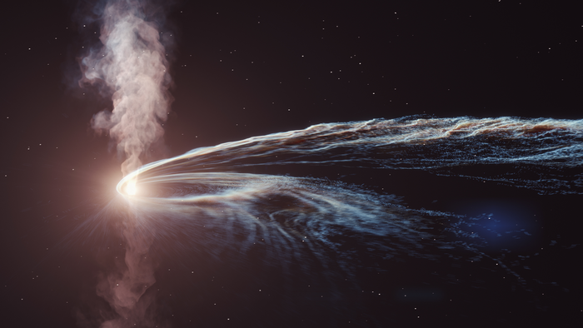


Inclination distributions in Tidal disruption events by spinning supermassive black holes
Tamanjyot Singh, Michael Kesden (UT Dallas)
arXiv: 2306.08054, under review in PRD
ICGC-2023, IIT Guwahati
Source: DESY, Science Communication Lab

Slide 2
TDEs: Why are we interested?
Most galaxies harbor a SMBH at their centers ^{[1, 2]} and not all of them actively accrete (AGNs or Quasars) ^{[3]}
Quiescent SMBHs are observable through the stellar encounters resulting tidal disruption events (TDEs). ^{[4]}
TDEs occur when a star gets stretched apart by tidal forces of SMBH resulting in bright electromagnetic flares. ^{[5]}
The debris from the disrupted star loses its energy and angular momentum via self collisions and viscous interactions to produce an accretion disk.
Rees (1988)

Slide 3
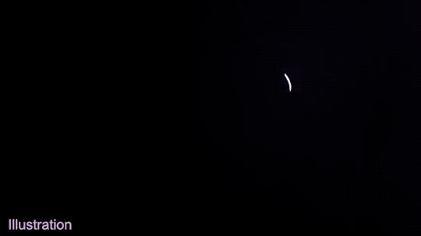
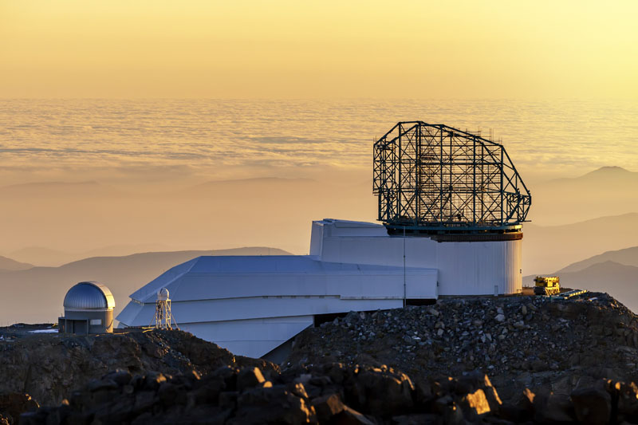
Observations: TDE candidates
These TDEs can be observed in several ways:
  Temporary flares of electromagnetic radiation from accretion.^{[1]}
  Accretion disk can result in quasi-periodic oscillations (QPOs).^{[2]}
  Leftover mass is thrown out resulting in jets.
More than 100 tidal disruption events^{[3]} (TDEs) have been observed through various surveys such as Pan-STARRS, ZTF, ASASSN, and others.
Thousands more TDEs are expected to be discovered in upcoming surveys like LSST, ULTRASAT, etc.
TDEs candidates^{[3]} have been found in –
  X-ray surveys,
  UV/Optical surveys, and recently
  Infrared surveys
NASA/Goddard
LSST

Slide 4
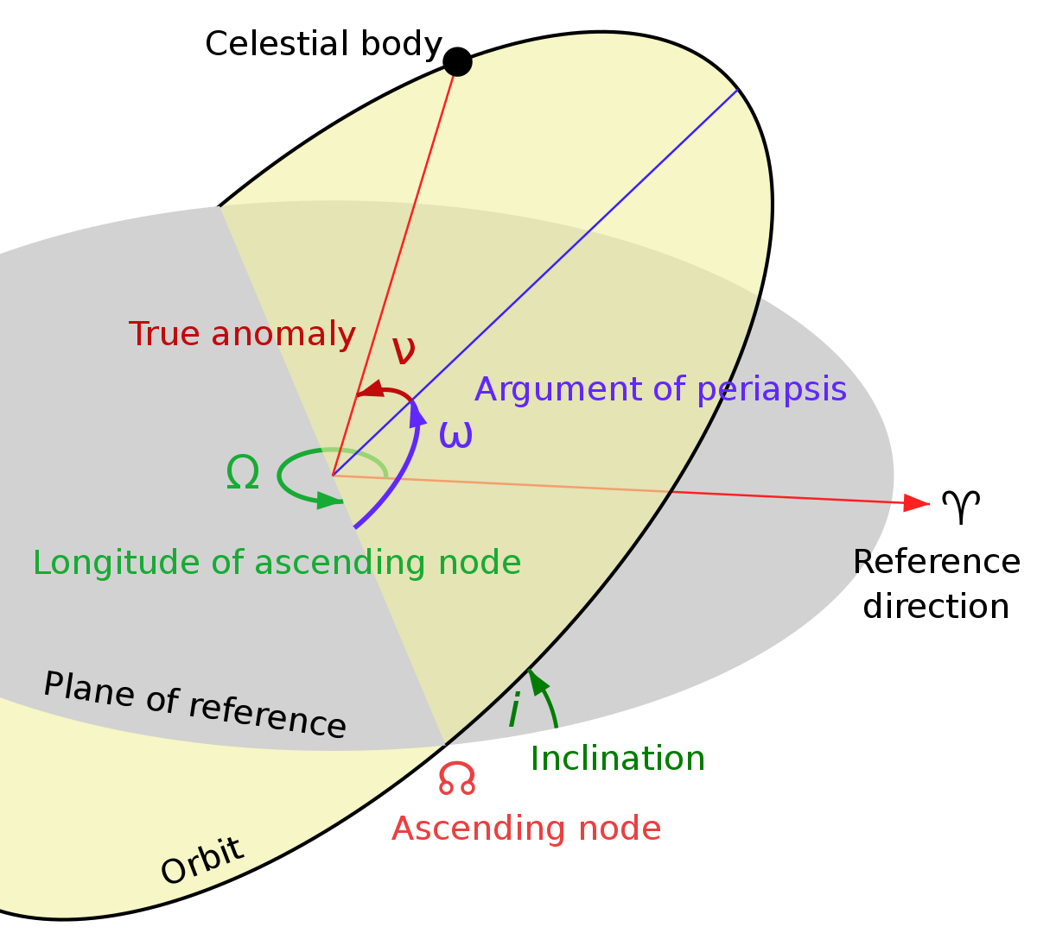
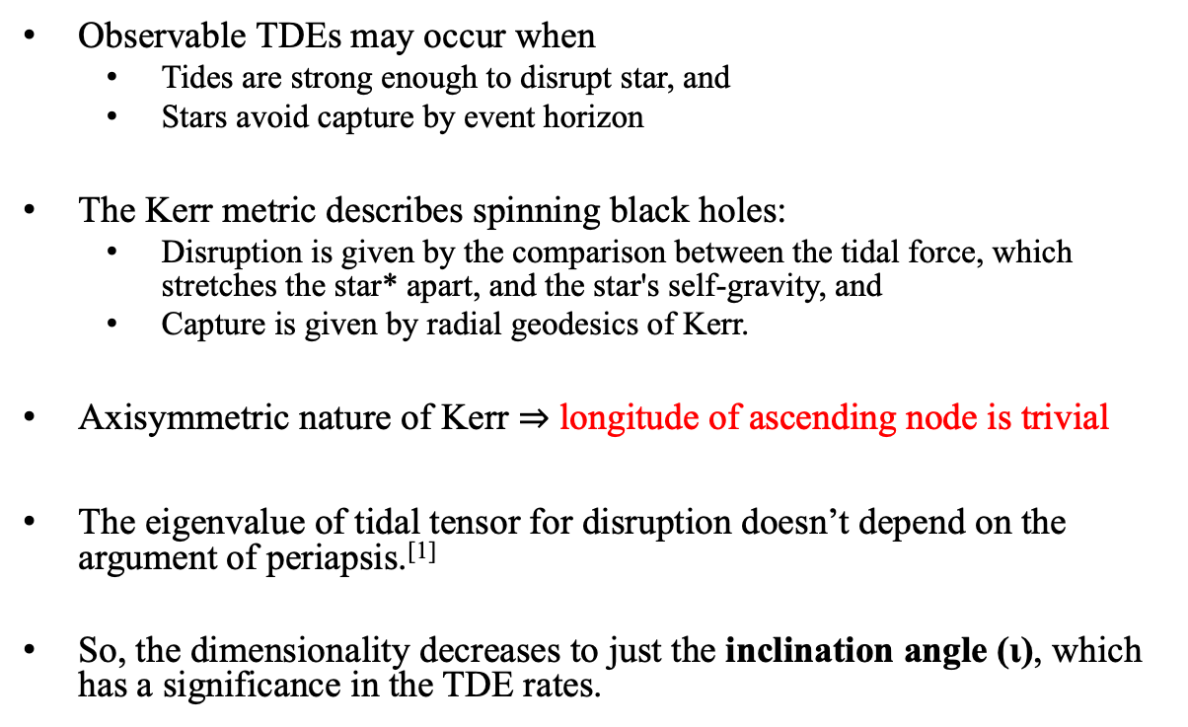
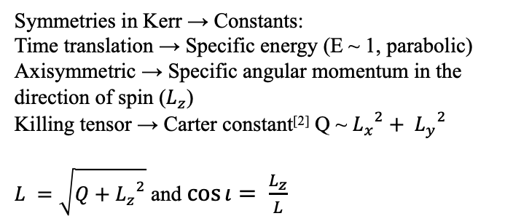
Disruption and capture
Observable TDEs may occur when
  Tides are strong enough to disrupt star, and
  Stars avoid capture by event horizon
The Kerr metric describes spinning black holes:
  Disruption is given by the comparison between the tidal force, which stretches the star* apart, and the star's self-gravity, and
  Capture is given by radial geodesics of Kerr.
Axisymmetric nature of Kerr $⇒$ longitude of ascending node is trivial
The eigenvalue of tidal tensor for disruption doesn’t depend on the argument of periapsis.^{[1]}
So, the dimensionality decreases to just the inclination angle (ι), which has a significance in the TDE rates.
Symmetries in Kerr → Constants:
Time translation → Specific energy (E ~ 1, parabolic)
Axisymmetric → Specific angular momentum in the direction of spin ($L_{z}$)
Killing tensor → Carter constant^{[2]} Q ~ ${L_{x}}^{2}+ {L_{y}}^{2}$
$L =\sqrt{Q+{L_{z}}^{2}}$ and $\cos{ι}= \frac{L_{z}}{L}$
*For our analysis we consider a sun-like star with similar properties
Notes:
In general relativity, a star is tidally disrupted when the tidal acceleration given by the geodesic-deviation equation exceeds the star’s self-gravity
Rank 2 killing tensor leads to a conserved quantity - carter constant

Slide 5
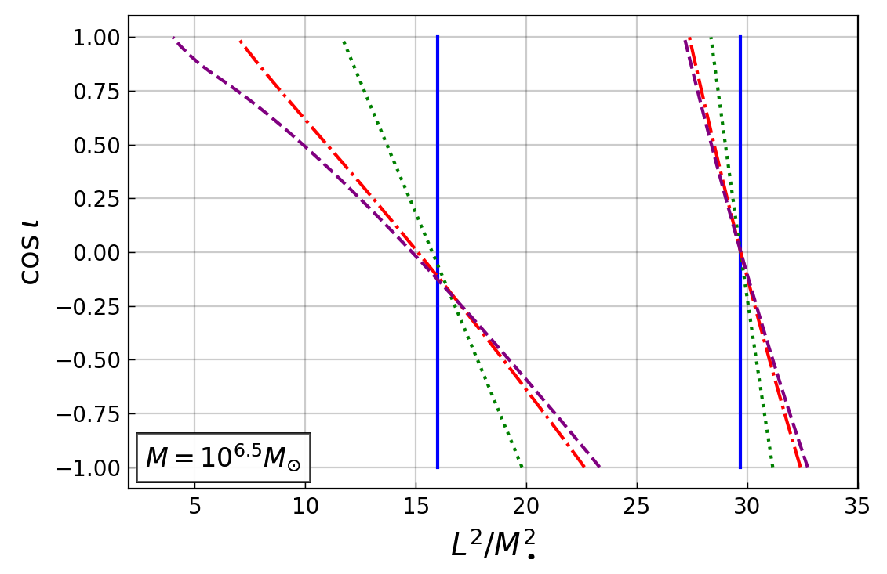
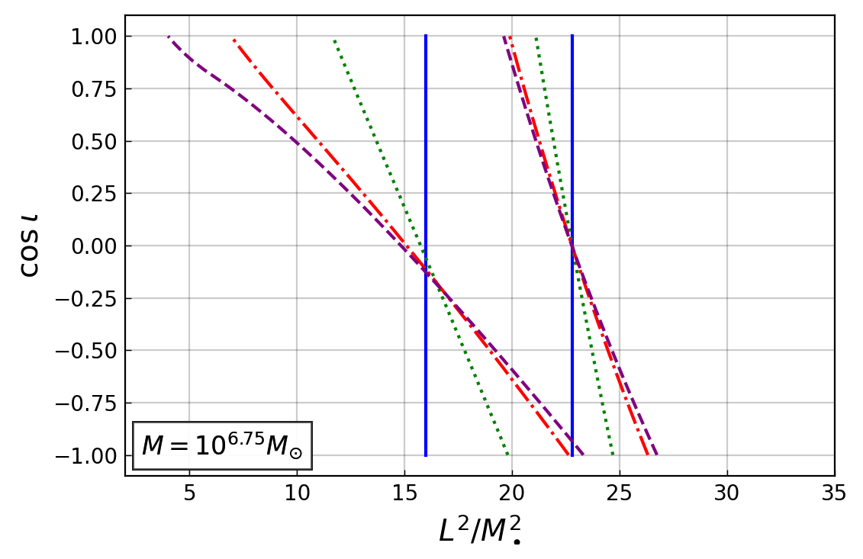
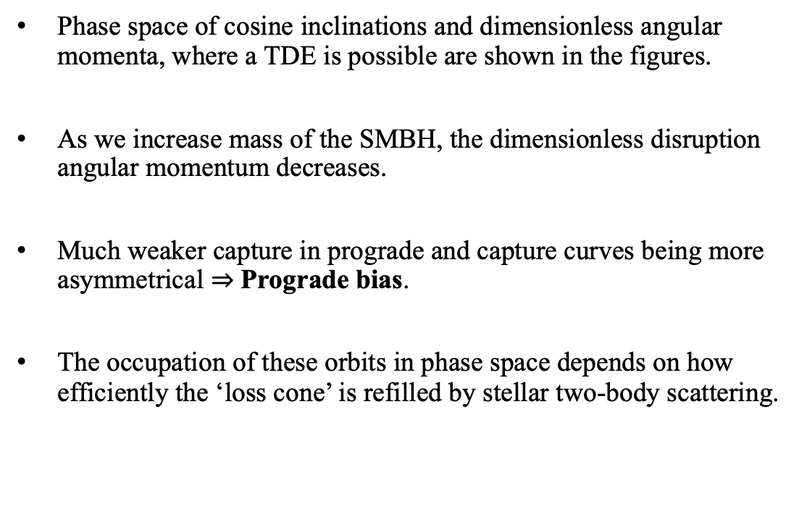
Distribution of inclinations
Disruption
Phase space of cosine inclinations and dimensionless angular momenta, where a TDE is possible are shown in the figures.
As we increase mass of the SMBH, the dimensionless disruption angular momentum decreases.
Much weaker capture in prograde and capture curves being more asymmetrical $⇒$ Prograde bias.
The occupation of these orbits in phase space depends on how efficiently the ‘loss cone’ is refilled by stellar two-body scattering.
Capture
Singh & Kesden (2023)
Blue solid line denotes for a non-spinning (Schwarzschild) black hole
Green dotted line denotes χ = 0.5
Red dash-dot line signifies χ = 0.9,
Purple dashed line signifies a maximally spinning black hole, χ = 1
Singh & Kesden (2023)
Notes:
As the SMBH at the center of galaxies make up only a sub percent of mass
Grav. radius is where relativistic effects become dominant

Slide 6


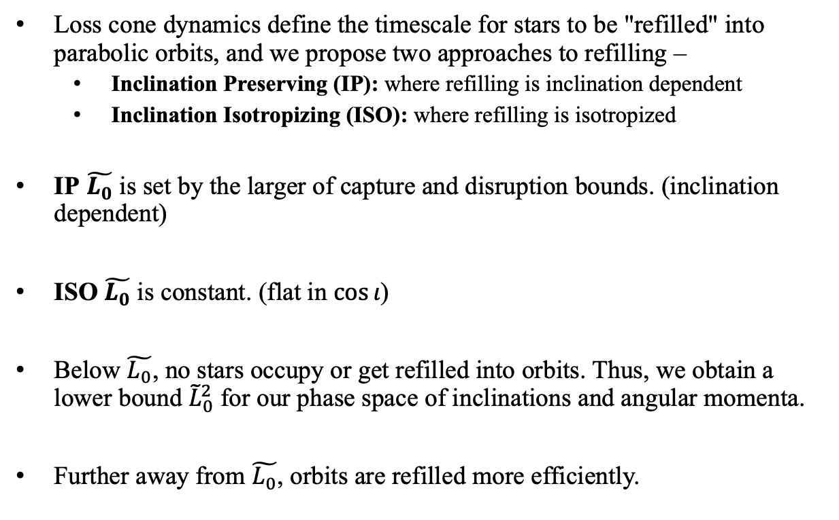



Loss cone dynamics
$$χ≠0$$
+1
Loss cone dynamics define the timescale for stars to be "refilled" into parabolic orbits, and we propose two approaches to refilling –
  Inclination Preserving (IP): where refilling is inclination dependent
  Inclination Isotropizing (ISO): where refilling is isotropized
IP $\tilde{L_{0}}$ is set by the larger of capture and disruption bounds. (inclination dependent)
ISO $\tilde{L_{0}}$ is constant. (flat in $\cos{ι}$)
Below $\tilde{L_{0}}$, no stars occupy or get refilled into orbits. Thus, we obtain a lower bound ${\tilde{L}}_{0}^{2}$ for our phase space of inclinations and angular momenta.
Further away from $\tilde{L_{0}}$, orbits are refilled more efficiently.
cos ι
L²/M²
-1
$$L_{0}^{2}/M2$$
$$\overline{L_{0}^{2}}/M2$$
$$L_{cap}^{2}/M2$$
$$L_{d}^{2}/M2$$
Blue – Capture angular momenta
Green – Disruption angular momenta
Grey highlight – Loss Cone
Red – Empty loss cone (preserving) angular momenta
Orange – Empty loss cone (isotropizing) angular momenta
Arrows indicate where the curves move as SMBH mass increases

Slide 7
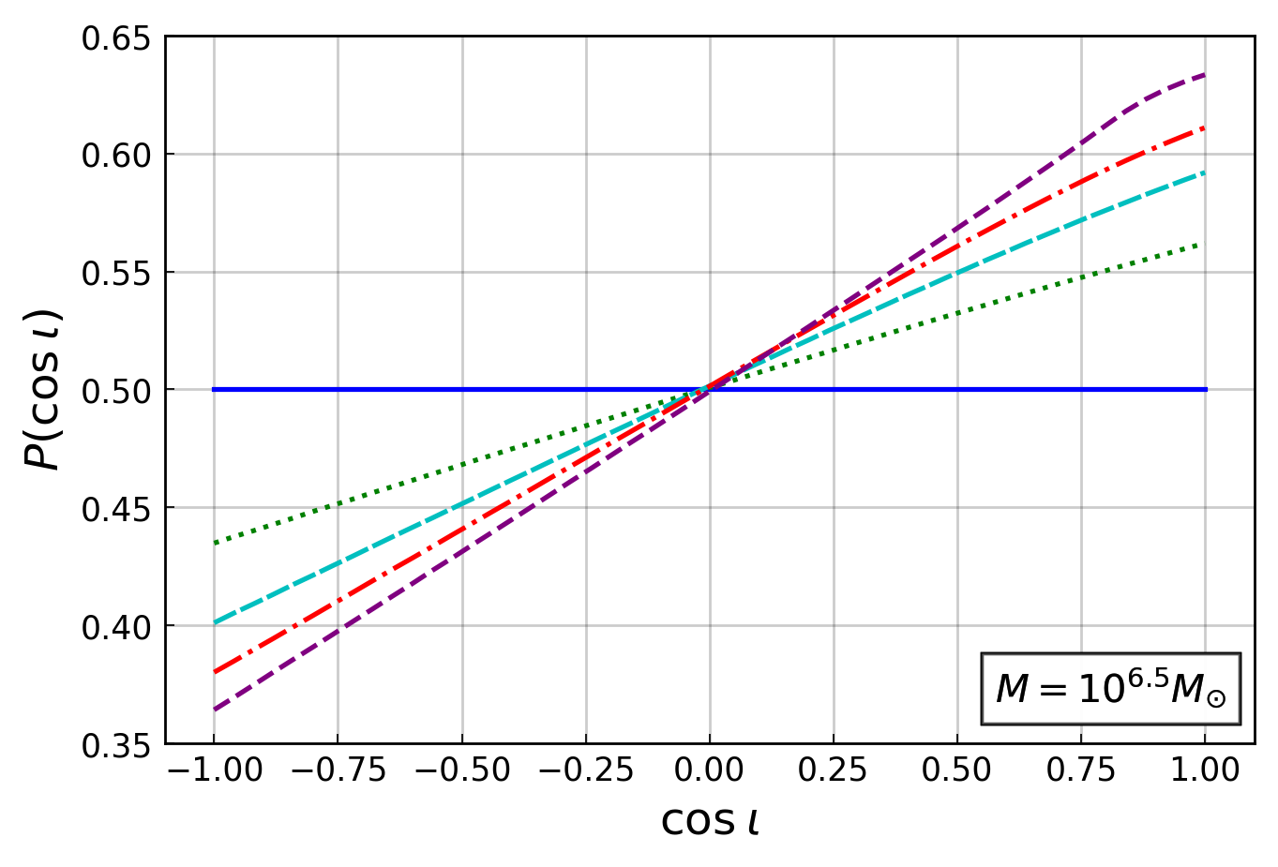
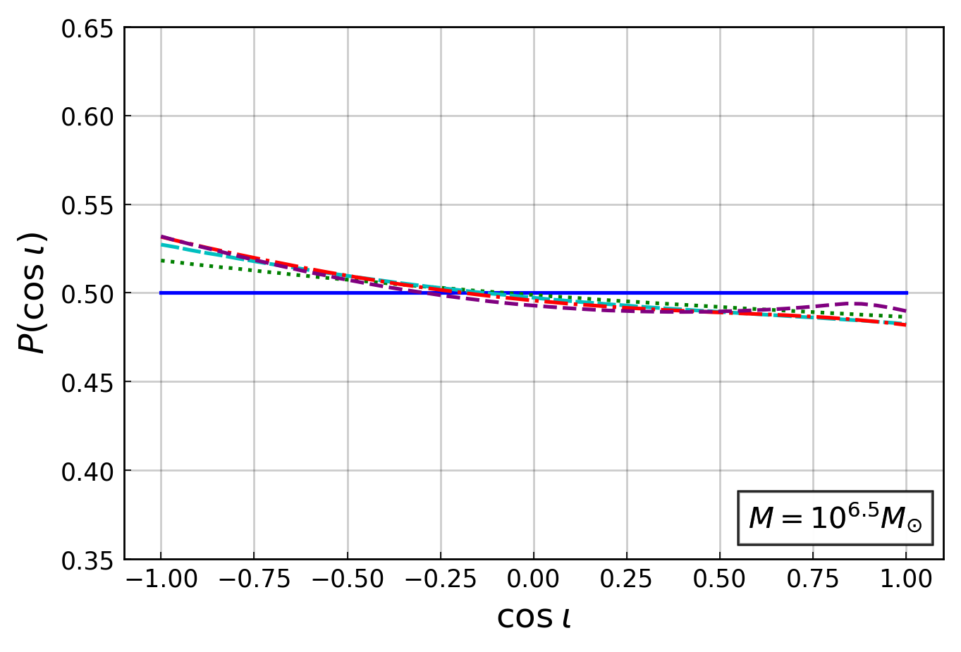
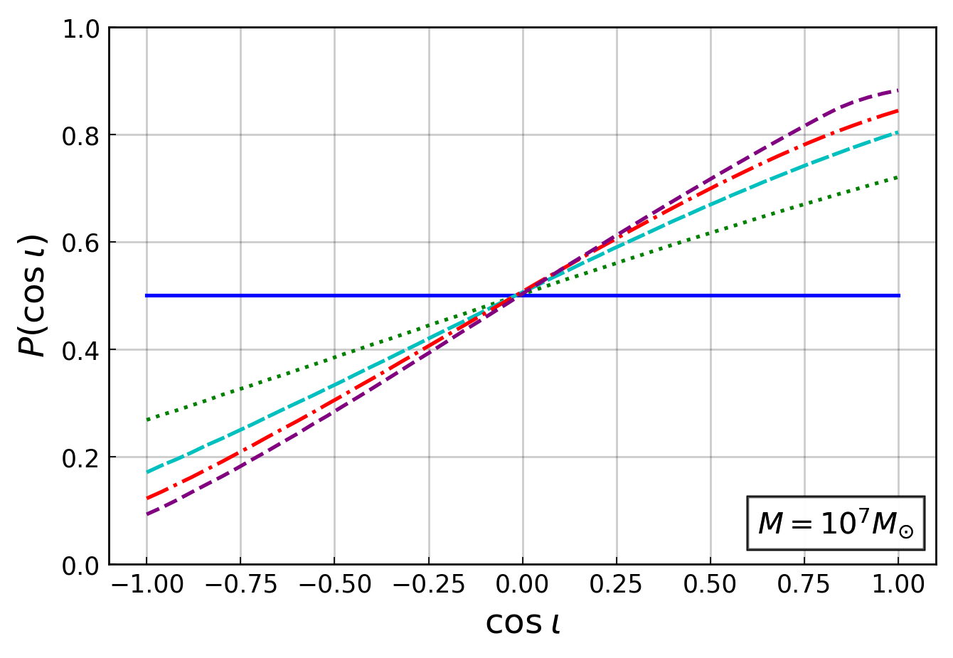
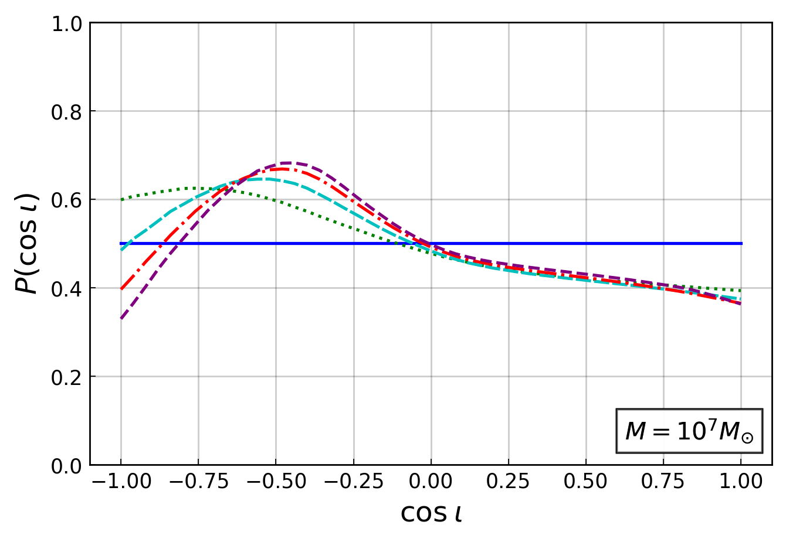
PDFs for different masses
IP
ISO
Blue solid line denotes for a non-spinning (Schwarzschild) black hole
Green dotted line denotes χ = 0.5
Red dash-dot line signifies χ = 0.9,
Purple dashed line signifies a maximally spinning black hole, χ = 1
Singh & Kesden (2023)

Slide 8
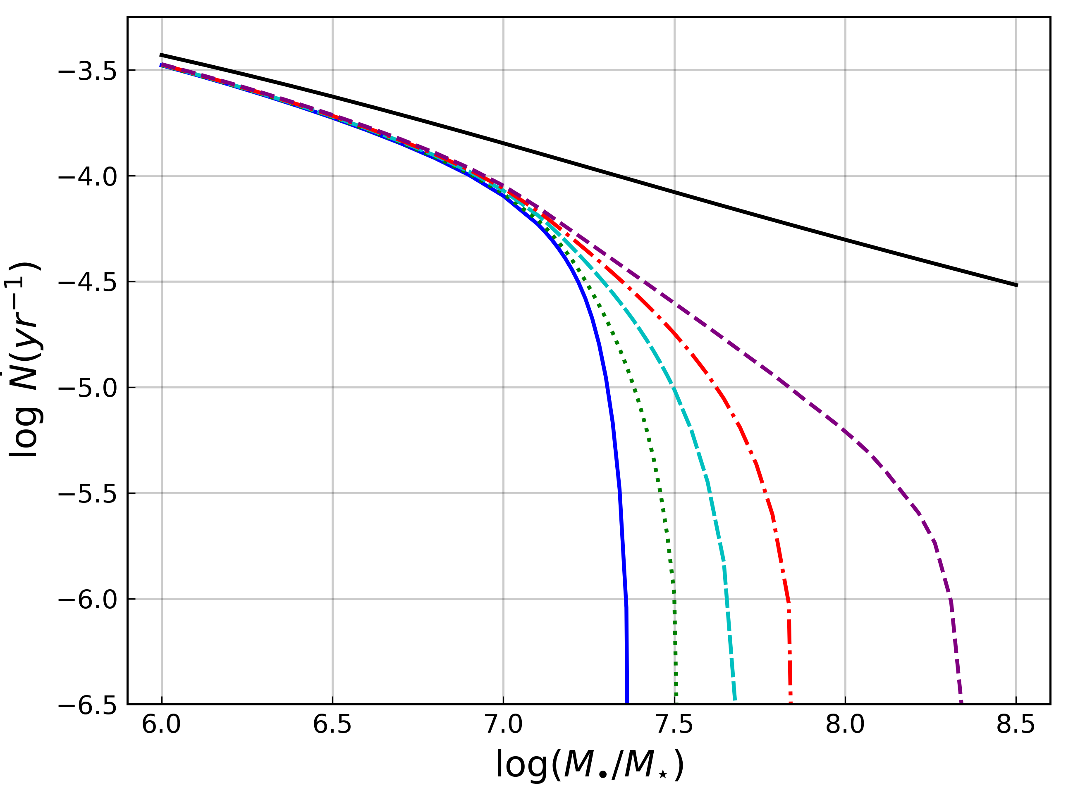
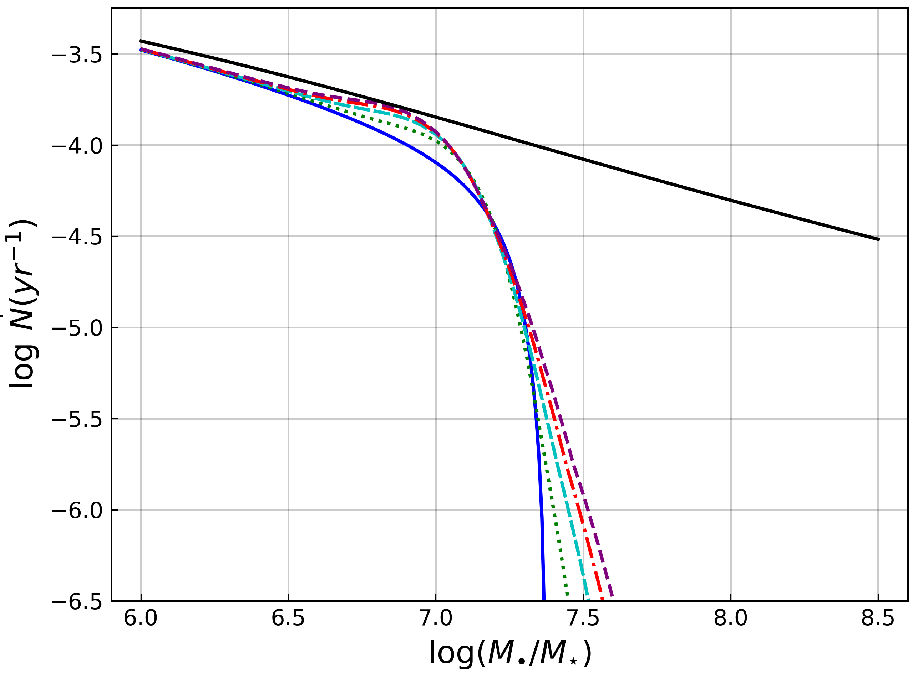

Total TDE rates
IP
Our distributions and total rates depend on:
  Mass of the SMBH ($M_{•}$),
  spin parameter (χ), and
  loss cone refilling approaches
To get the total rates of TDEs for each loss cone refilling approach, we integrate over the whole phase space.
For reference, we compare these to Newtonian rates with the same loss cone considerations.^{[1]}
We get much-suppressed rates because there are no captures in the Newtonian case, while we lose orbits to capture.
Singh & Kesden (2023)
ISO
Black solid line is for Newtonian case
Blue solid line denotes χ = 0
Green dotted line denotes χ = 0.5
Cyan dashed line is χ = 0.75
Red dash-dot line signifies χ = 0.9,
Purple dashed line signifies χ = 1
Notes:
Low spin dependence for low masses in preserving loss cone because empty loss cone curves are parallel to disruption curves and less significant capture effects at low mass.
But as the mass increases, disruption curves move closer to capture and the asymmetrical nature of capture shows its effects on rates.
For isotropizing loss cone, we get a spin dependence for low masses because now loss cone curves are averaged and ‘straight vertical lines’ such that retrograde orbits are weighed heavier by the $f_{ELC}$ factor.
But as the mass increases, we lose the retrograde orbits, and the rates are much suppressed as loss cone curves start intersecting capture curves.

Slide 9
Observational implications/future work
Challenge ahead is to determine how these rates and inclination distributions affect –
  Bolometric energy radiated from accretion at the innermost stable circular orbit (ISCO)^{[1]}
  Amplitudes and frequencies of quasi-periodic oscillations (QPOs)^{[2]}
  Delay times in collisions due to relativistic precession^{[3,4]}
  Ability of a TDE to launch relativistic jets^{[5]}
DESY, Science Communication Lab
Notes:
To our knowledge, this is the first work explicitly focused on the distribution of TDE inclinations

Slide 10
Thanks!
10

Slide 11
Bonus Slides:
11

Slide 12
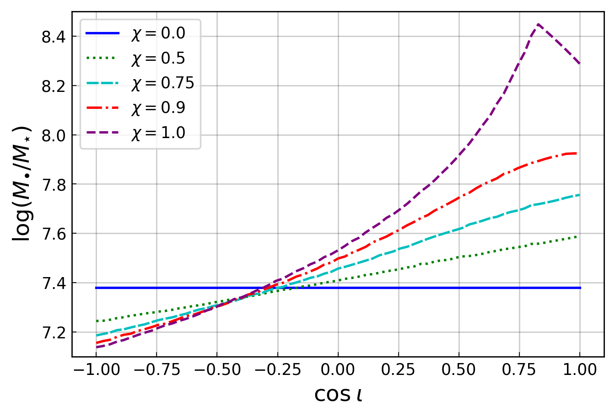
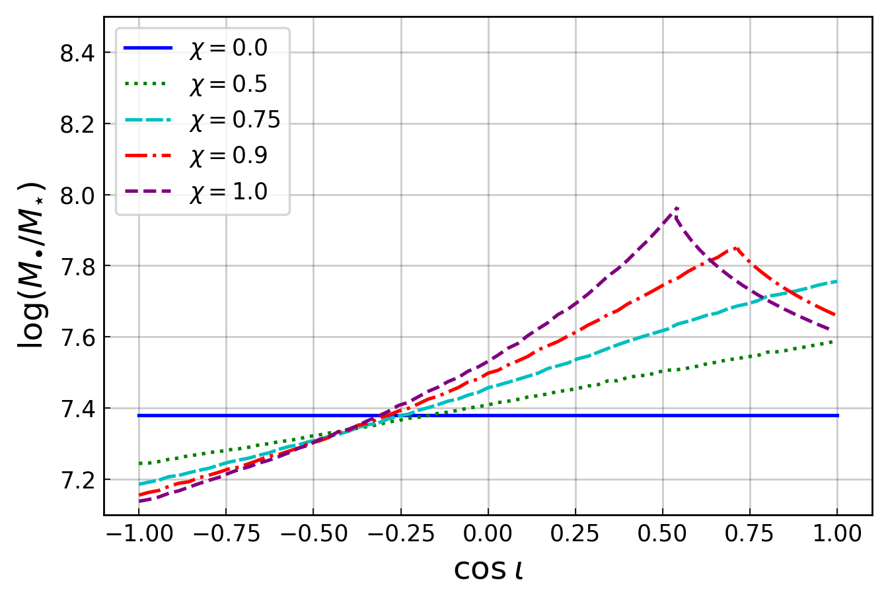
Maximum mass for observable TDE
IP
As the disruption curves and loss cone curves are moving towards the capture curves, we lose orbits ‘eligible’ for disruption.
So, for each inclination, we will have an upper bound on the mass at which disruption can occur.
IP empty loss cone curves exponentially approach capture curves, so, only capture and disruption curves determine this mass.
But for ISO empty loss cone, the averaged value of loss cone angular momenta can intersect capture curves and we lose prograde disruptions to loss cone.
Singh & Kesden (2023)
ISO

Slide 13


Loss Cone – Inclination Preserving
$${\tilde{L_{0}}}^{2}≈{\tilde{L_{lc}}}^{2}e^{−{\left(q^{2}+q^{4}\right)}^{1/4}}$$
+1
Blue – Capture angular momenta
Green – Disruption angular momenta
Yellow highlight – Loss Cone
Red – Empty loss cone (preserving) angular momenta
cos ι
L²/M²
Retrograde orbits are lost to capture. Stars get engulfed by the BH before the tidal forces are strong enough to disrupt them.
-1
$$L_{0}^{2}/M2$$
$$L_{d}^{2}/M2$$

Slide 14

Loss Cone – Inclination Isotropizing
Region between these curves signifies that there are no stars in loss cone to disrupt though we can in principle have some orbits in our phase space that can be ‘eligible’ for disruption here.
+1
Blue – Capture angular momenta
Green – Disruption angular momenta
Yellow highlight – Loss Cone
Red dashed – Empty loss cone (preserving) angular momenta
Red – Empty loss cone (isotropizing) angular momenta
cos ι
L²/M²
-1
$$\overline{L_{0}^{2}}/M2$$
$$L_{d}^{2}/M2$$

Slide 15
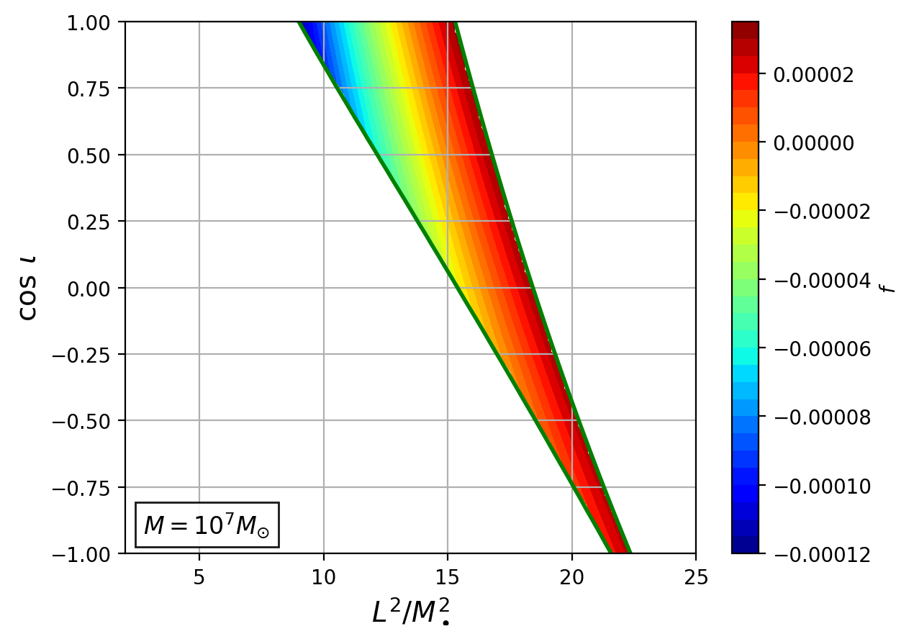
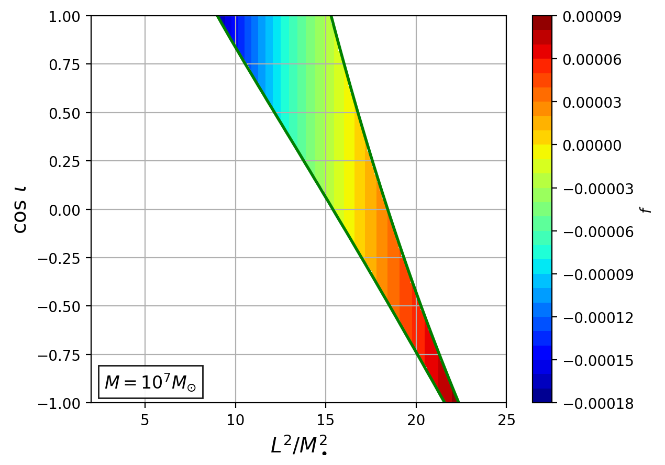
Occupation fraction in different loss cone approaches
IP
ISO

Slide 16
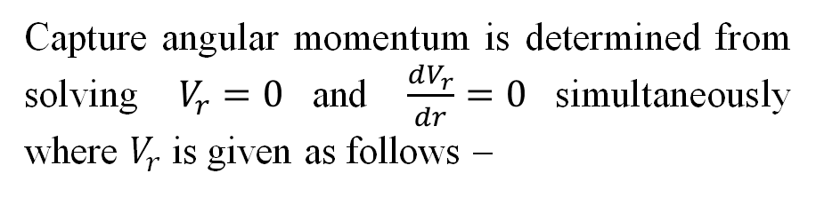
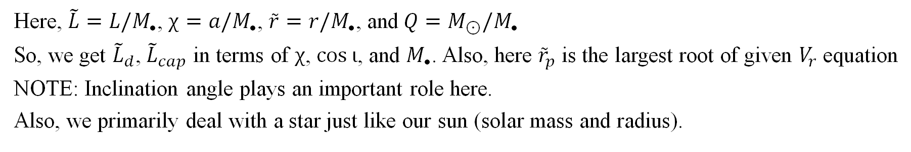
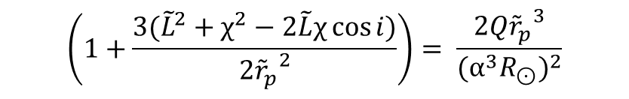
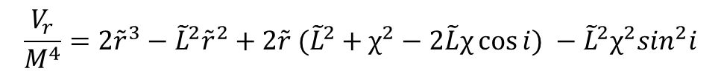
Disruption and Capture
Disruption means the tidal force exerted by the SMBH’s tidal tensor on the star overcomes the self gravity of the star. Hence the star gets disrupted, this depends on the orbital angular momentum of the star as follows –
Capture angular momentum is determined from solving $V_{r}=0$and $\frac{dV_{r}}{dr}=0$simultaneously where $V_{r}$ is given as follows –
$$\frac{V_{r}}{M^{4}}=2{\tilde{r}}^{3}−{\tilde{L}}^{2}{\tilde{r}}^{2}+2{\tilde{r} (\tilde{L}}^{2}+χ^{2}−2\tilde{L}χ\cos{i}) −{\tilde{L}}^{2}χ^{2}\sin^{2}i$$
$$\left(1+\frac{3({\tilde{L}}^{2}+χ^{2}−2\tilde{L}χ\cos{i})}{2{{\tilde{r}}_{p}}^{2}}\right)= \frac{2Q{{\tilde{r}}_{p}}^{3}}{{(α^{3}R_{⊙})}^{2}}$$
Here, $\tilde{L}=L/M_{•}$, $χ=a/M_{•}$, $\tilde{r}=r/M_{•}$, and$Q=M_{⊙}/M_{•}$
So, we get ${\tilde{L}}_{d}$, ${\tilde{L}}_{cap}$ in terms of $χ$, $\cos{ι}$, and $M_{•}$. Also, here ${\tilde{r}}_{p}$ is the largest root of given $V_{r}$ equation
NOTE: Inclination angle plays an important role here.
Also, we primarily deal with a star just like our sun (solar mass and radius).

